Slide 1
CISC/CMPE 472
PET Imaging
and Reconstruction
[ Images from “Positron Emission Tomography - Basic Sciences” D Bailey, D Townsend, P Valk, M Maisey ]

Slide 2
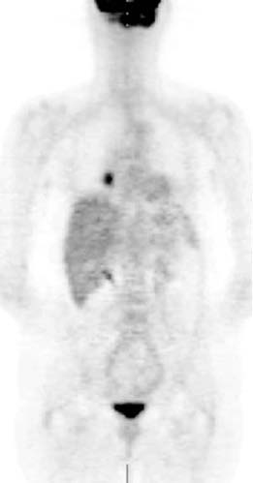
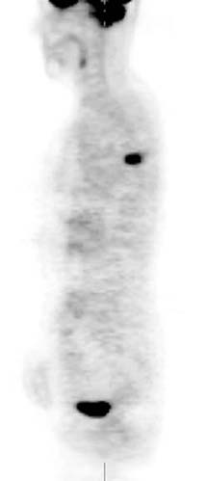
Contrast
[ Maisey ]
Areas of high metabolic activity

Slide 3
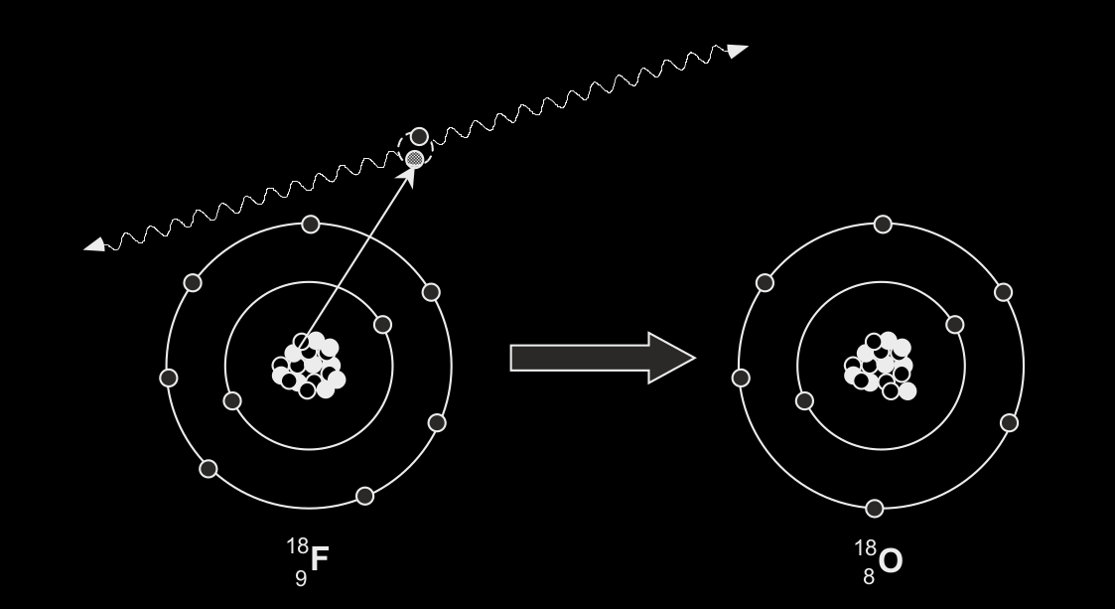
Contrast
“Proton-rich” nucleus
[ Bailey,Karp,Surti ]

Slide 4
Contrast
[ Bailey,Karp,Surti ]

Slide 5
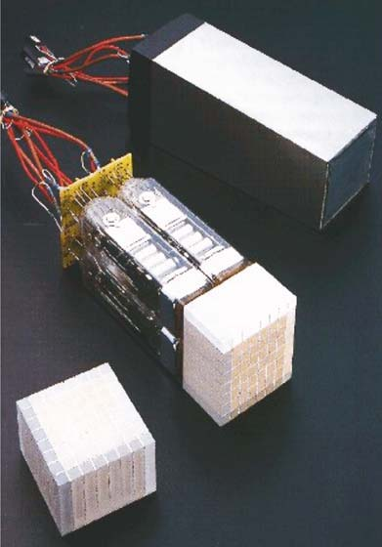
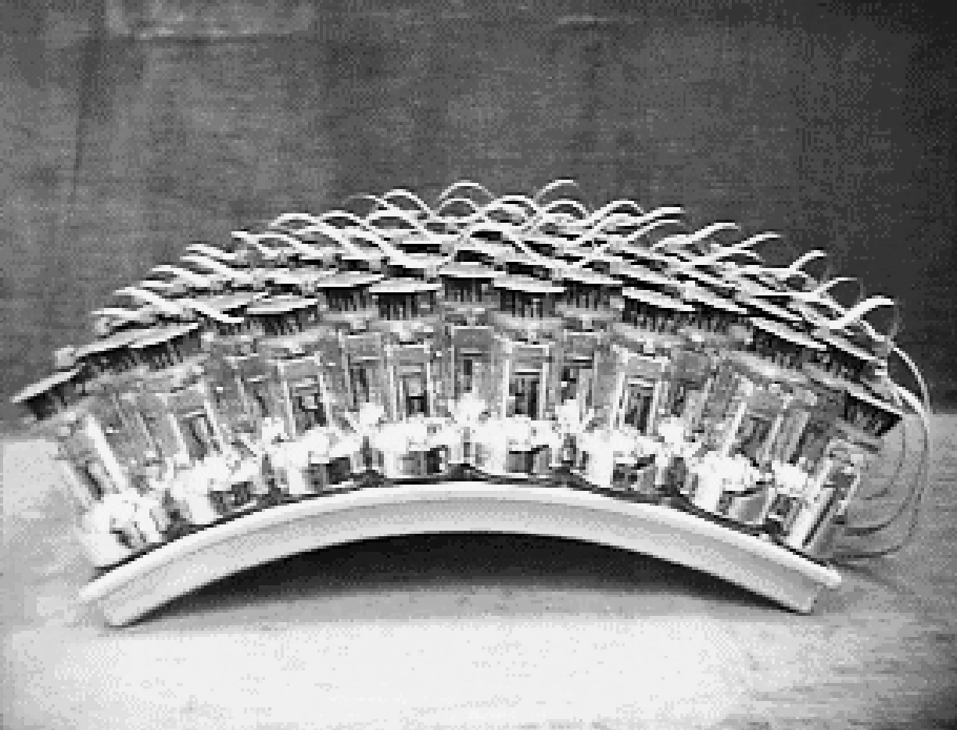
Contrast
8x8 groups of detector elements
[ J Karp, UPenn ]
[ Bailey,Karp,Surti ]

Slide 6
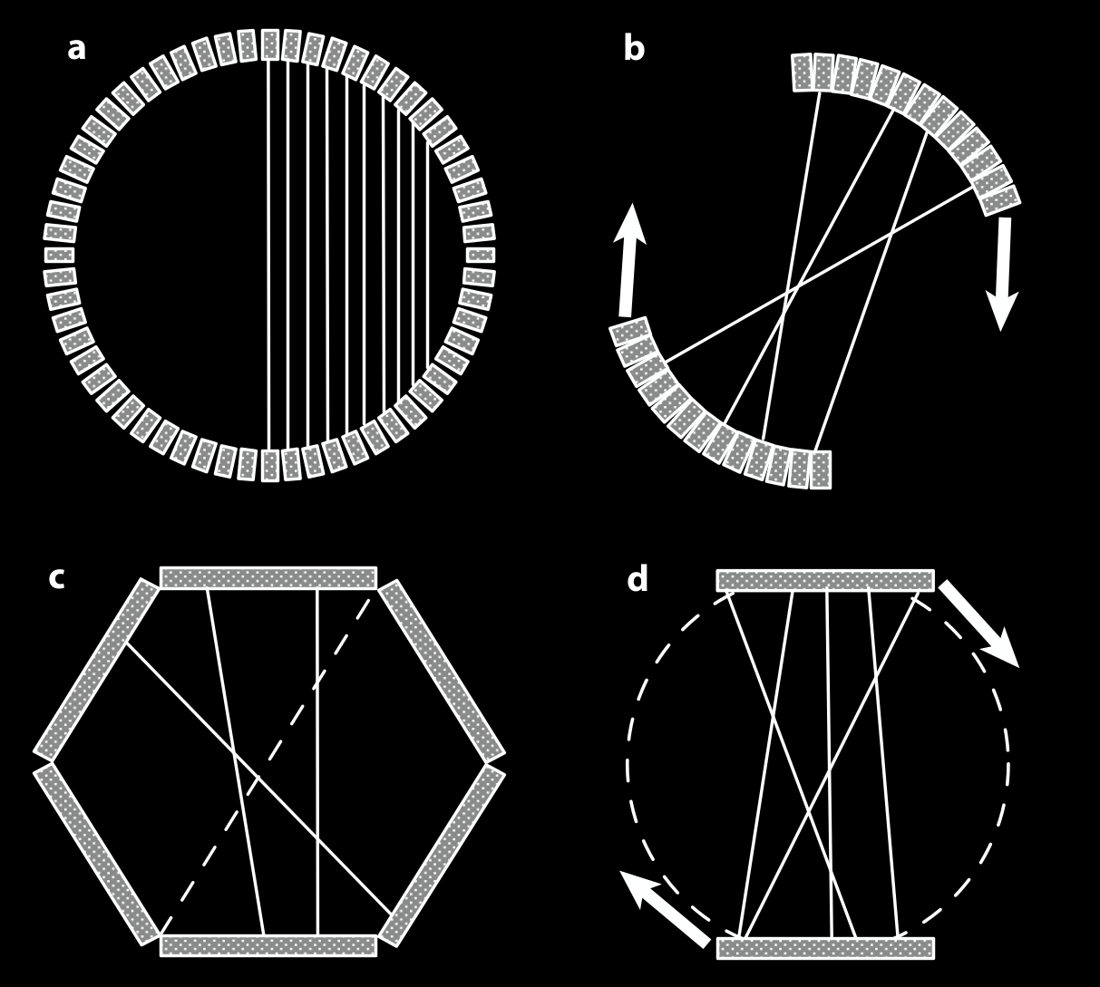
Contrast
Detector configurations
[ Bailey ]

Slide 7
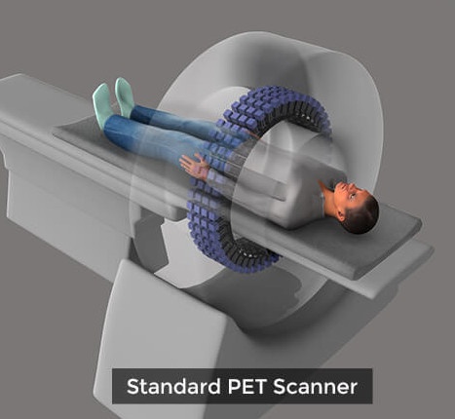
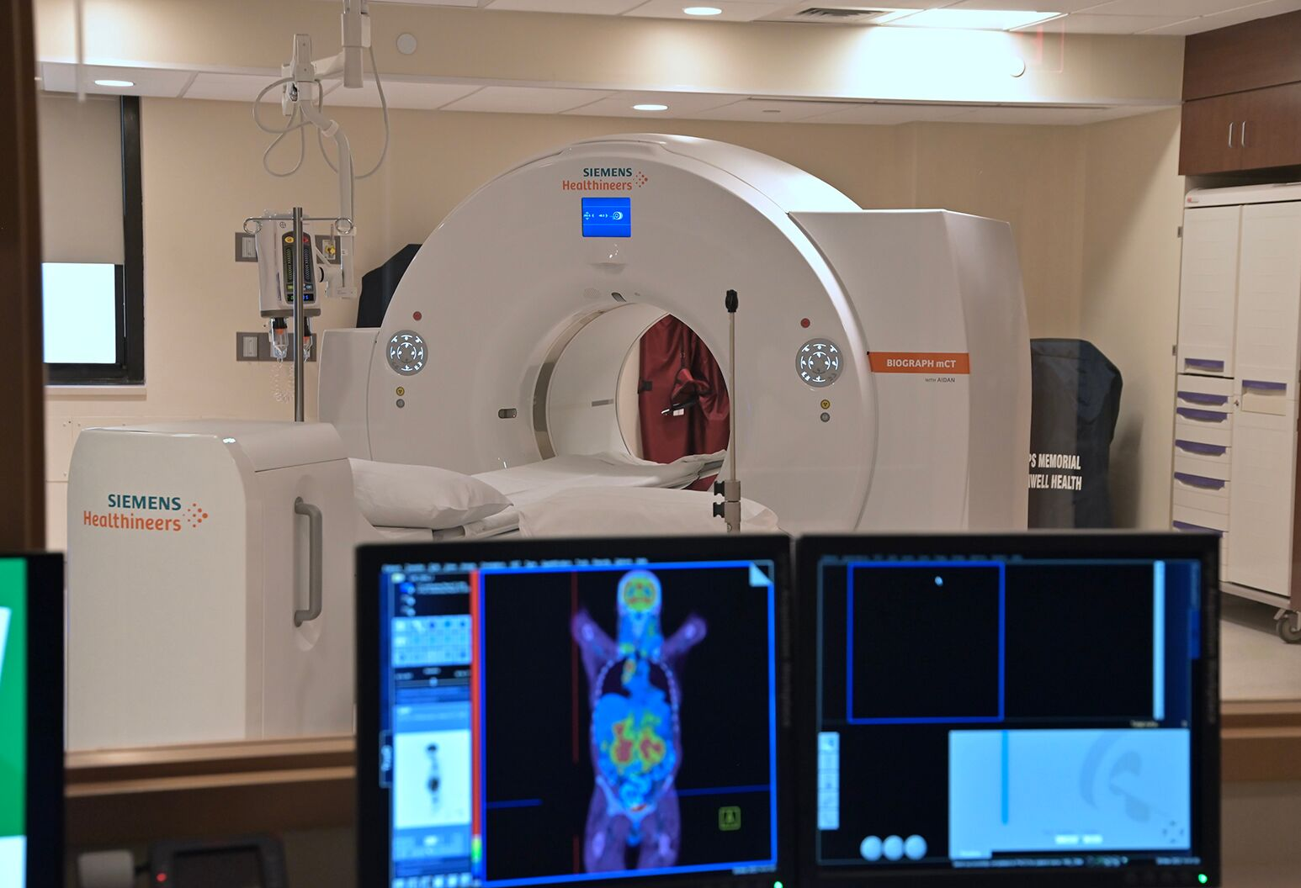
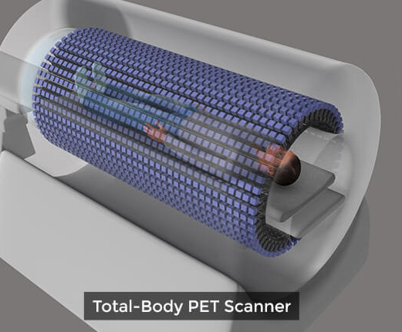
Contrast
PET + CT scanner

Slide 8
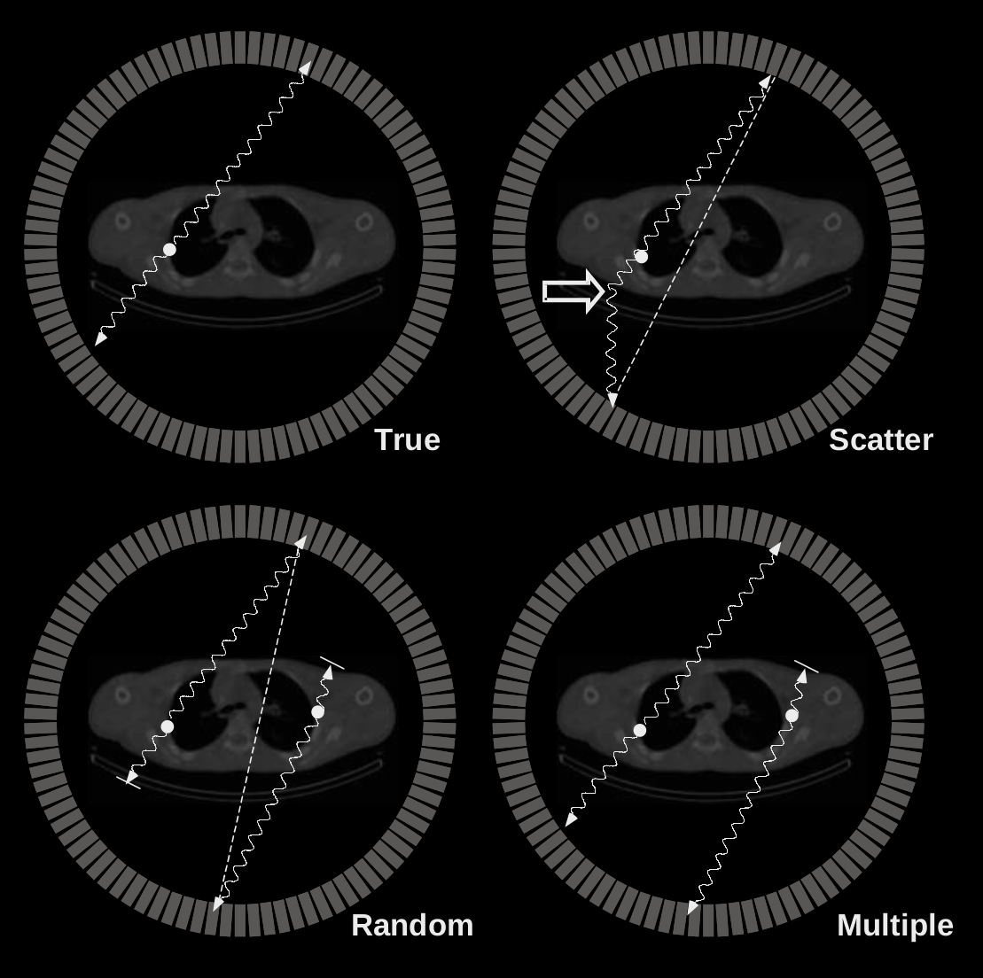
Contrast
Events
[ Bailey ]

Slide 9
Contrast
Reconstruction Methods
Backprojection
Filtered Backprojection
Algebraic Reconstruction
MLEM: Maximum Likelihood Expectation Maximization
OSEM: Ordered Subsets Expectation Maximization

Slide 10
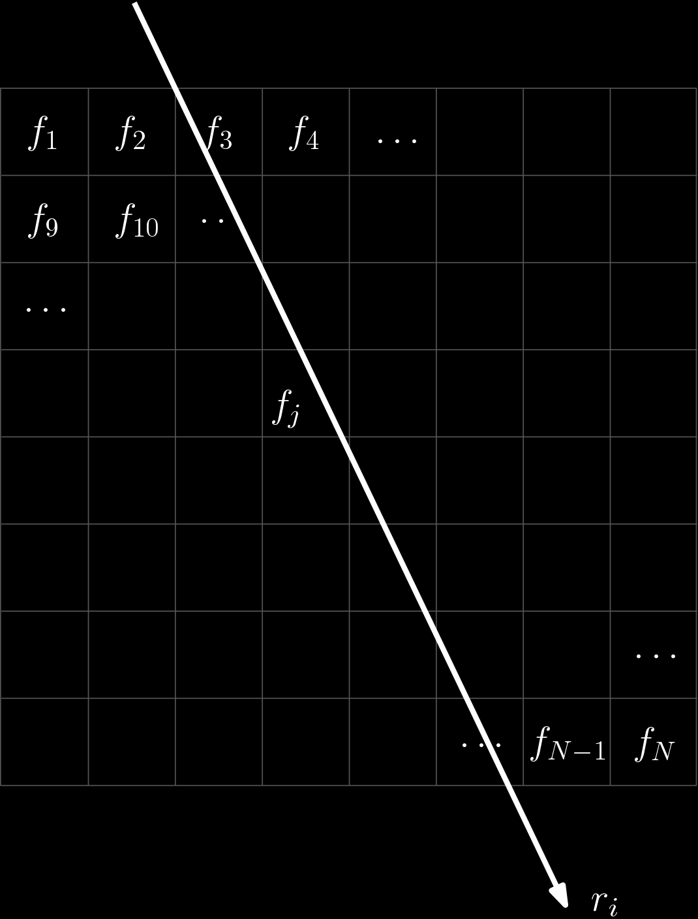
Contrast

Slide 11
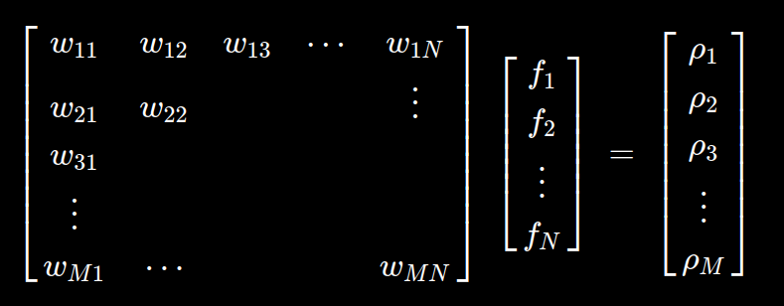
Contrast

Slide 12
Contrast

Slide 13
Contrast
MLEM: Maximum Likelihood Expectation Maximization
Find the best estimate of f satisfying W f = p.
“Best” means “maximize the likelihood function of the reconstructed image”.
i.e. Find f that would produce p with highest likelihood.
The events (i.e. radioactive disintegrations) have variation that follows a Poisson model.

Slide 14
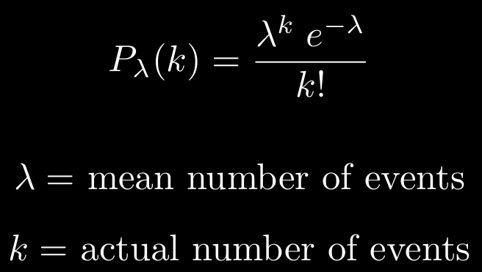
Contrast
Poisson Model

Slide 15
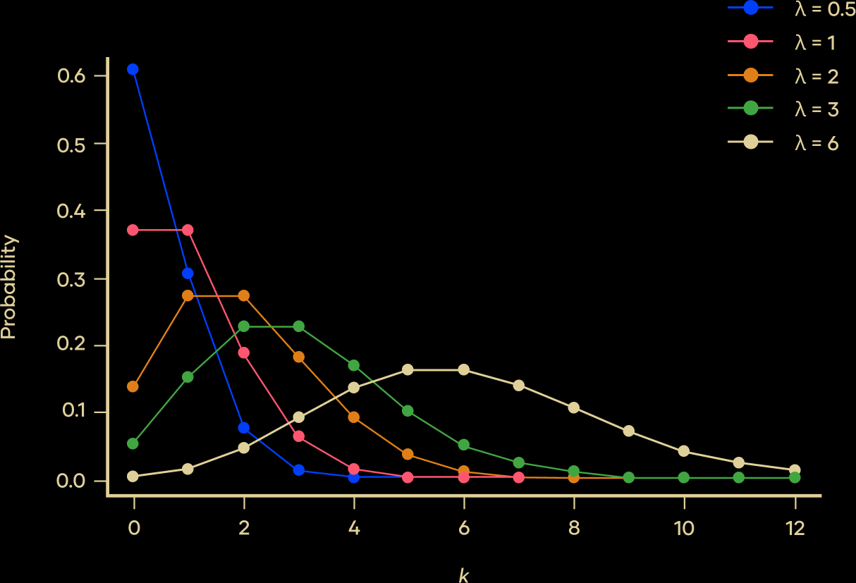
Contrast
Poisson Model

Slide 16
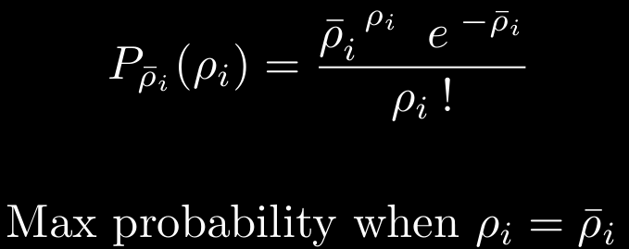
Contrast
Poisson Model

Slide 17
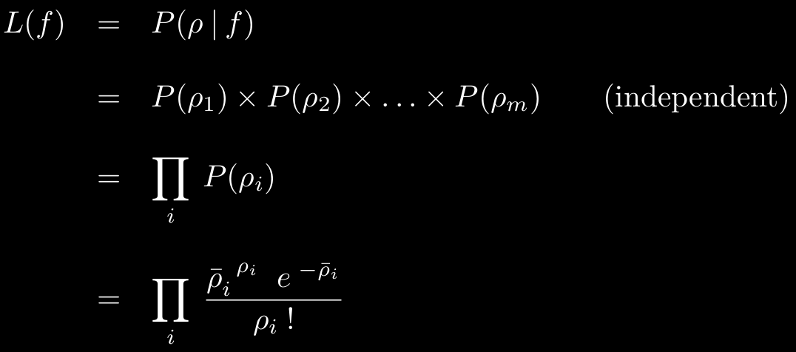
Contrast
Likelihood of f

Slide 18
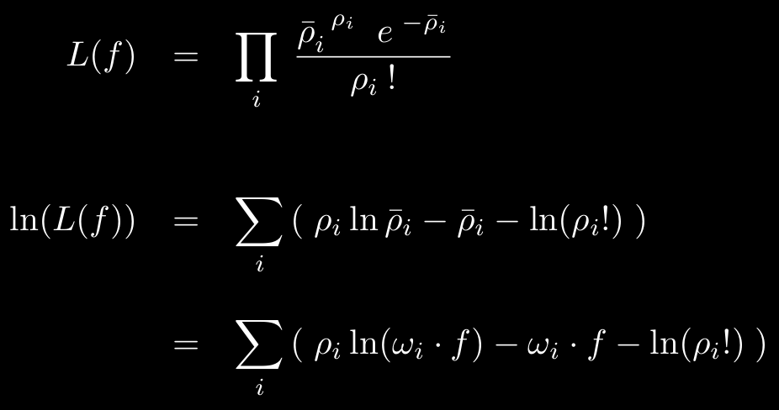
Contrast
Log likelihood of f

Slide 19
Contrast
Log likelihood of f

Slide 20
Contrast
Log likelihood of f is maximized when derivative is zero

Slide 21
Contrast
Log likelihood of f is maximized when derivative is zero

Slide 22
Contrast
Log likelihood of f is maximized when derivative is zero

Slide 23
Contrast
Drive f toward its maximum likelihood

Slide 24
Contrast
Drive f toward its maximum likelihood

Slide 25
Contrast

Slide 26
Contrast

Slide 27
Contrast

Slide 28
Contrast

Slide 29
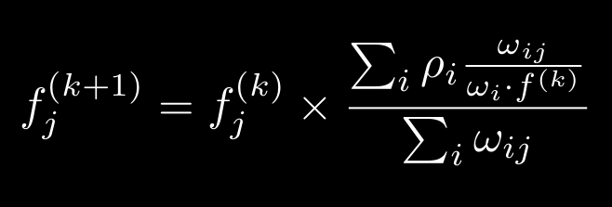
Contrast
MLEM Summary
MLEM converges slowly with 50-200 iterations (each processing all voxels, j).
Could include attenuation and blurring in the model, W.

Slide 30
Contrast
OSEM: Ordered Subsets Expectation Maximization
Choose subsets of the detector pairs, with evenly distributed pairs in each subset.
Apply MLEM to each subset. f ^{(*)} after one subset is used as f ⁽⁰⁾ for next subset.
For s subsets, OSEM accelerates MLEM by a factor of s (up to some max).

Slide 31
Contrast
Filtered Backprojection, smoothed

Slide 32
Contrast
OSEM, smoothed

Slide 33
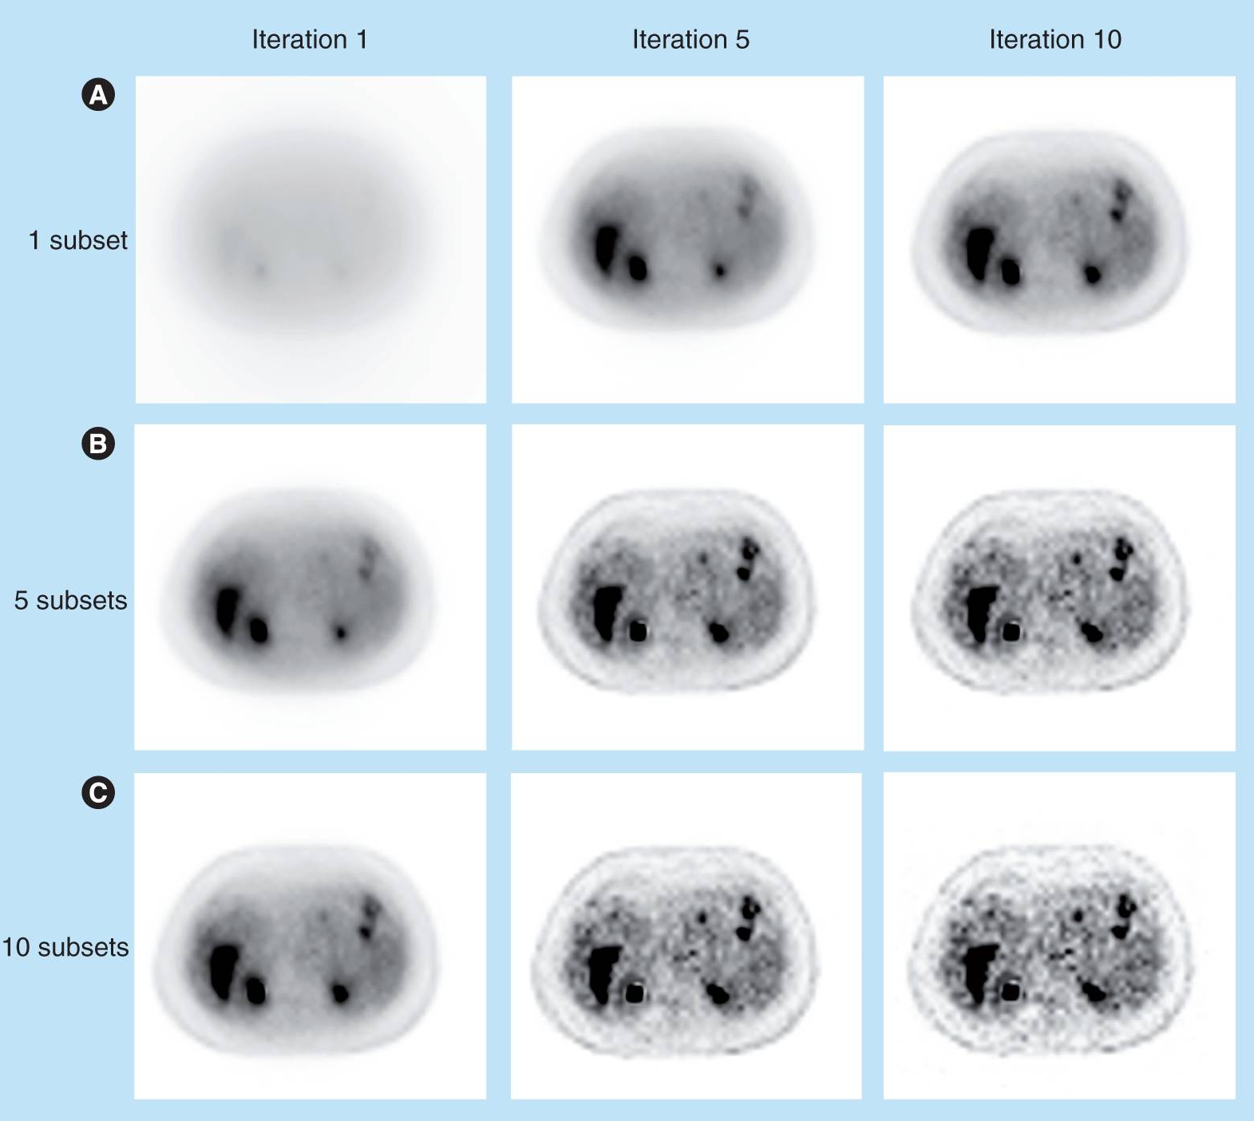
Contrast
MLEM vs OSEM

Slide 34
Contrast

